Slide 1
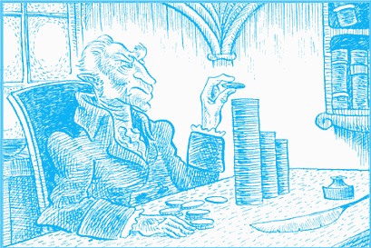
The Greedy Approach

Slide 2
Objectives
Describe the Greedy Programming Technique
Identify when greedy programming should be used to solve a problem
Identifying if greedy algorithm produces optimal solution
Solve optimization problems using the greedy approach

Slide 3
Algorithms for Optimization problems
Dynamic programming is one of the algorithms for optimization problems
However, DP can require a lot of memory and computation for determining the best solution.
Some problems may not need the full power of DP.
So, while DP is powerful, it’s not always the best tool for every optimization problem.
Simpler, more efficient algorithms is needed like greedy algorithms

Slide 4
Greedy Approach
For Solving optimization problems
Greedy-problem is not divided into smaller sub-problems!
Obtain a solution by making a sequence of choices, each choice appears to be the best choice at that step (local search strategy → Locally optimal)
Once a choice is made, it cannot be reconsidered
Choice made without considering previous or future choices
Do not always yield optimal solutions

Slide 5
Greedy Algorithm
Initialize the Solution: Start with an empty set.
Iterative Selection:
Choose the best available option based on a greedy criterion.
Ensure the selected choice satisfies problem constraints.
Add the selected item to the solution set.
Repeat Until Completion: Continue the selection process until no more choices can be made or the original problem is solved.

Slide 6
Example: Make a Change Problem
Problem:
How to make a change for clients in a store? Clients do not like so many coins!
Goal:
Make a change for clients with minimum number of coins
Any idea for the solution?
Select the biggest available coin
See if it is feasible
Then move to the next biggest coin and apply the same method

Slide 7
Make a Change Algorithm
while (there are more coins, and the instance is not solved)
{
grab the largest remaining coin;
if (adding the coin makes the change exceed amount owed)
{reject coin; }
else
{ add the coin to the change; }
if (total value of the change equals the amount owed)
{ the instance is solved; }
}
Selection procedure
Feasibility check
Solution check

Slide 8
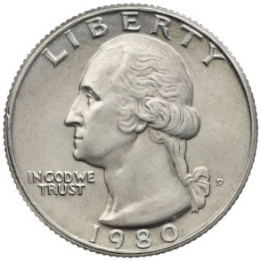
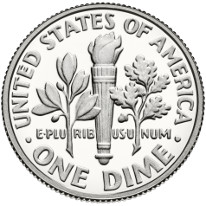
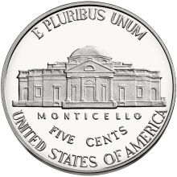
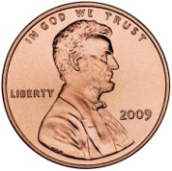
Example of the Algorithm
Available coins:
Amount owed: 36 cents
Not feasible
Not feasible
Problem solved!

Slide 9
Analysis of the Algorithm
The algorithm is “greedy”. Why?
Once an item (coin) is decided, the decision will not change
It is a simple approach!
Is it optimal solution?
Are the selected coins the minimum possible?

Slide 10
Analysis of the Algorithm (2)
How about if we had a 12 cents coin?
We owe 16 cents
Response of the greedy: 12, 1, 1, 1, 1→ 5 coins
Optimal response: 10,5, 1 → 3 coins
12

Slide 11
Review: 0-1 Knapsack Problem
S={item₁, item₂,…,item_{n}}
w_{i}: weight of item_{i}
p_{i}: profit of item_{i}
W: maximum weight the knapsack can hold
We have 1 instance from each item
Goal:
is maximized subject to

Slide 12
Review: DP Approach for 0-1 Knapsack Problem
M[i , w]= max{ (v_{i} +M[i-1 , w-w _{i}]), M[i-1 , w]}
If w_{i} > w (item i not included) then M[i , w]= M[i-1,w]
M[0,w]=0
M[i,0]=0
M[i , w] :

Slide 13
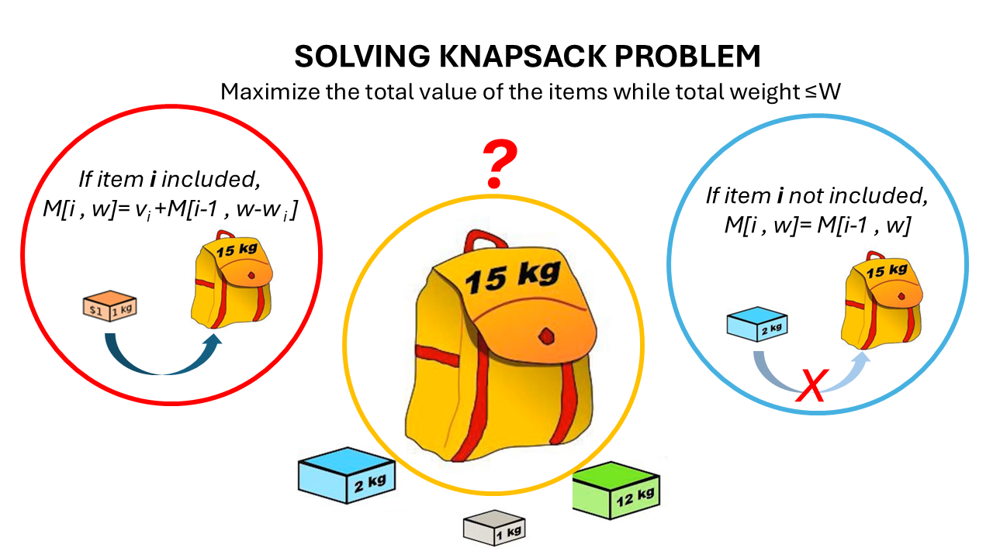
Review: DP Approach for 0-1 Knapsack Problem

Slide 14
Greedy Approach for 0-1 Knapsack Problem
Greedy ideas?
Largest value first.
If limit W=30
Item 3 and then 2 are picked (total value=200) optimal solution
How about for this example?
Item | 1 | 2 | 3
Weight(W) | 5 | 10 | 20
Value(V) | 50 | 60 | 140
Item | 1 | 2 | 3
Weight | 25 | 10 | 10
Value | 10 | 9 | 9
Item 1 is picked (total value=10) Not optimal solution

Slide 15
Greedy Approach for 0-1 Knapsack Problem
Greedy ideas?
Largest value per unit weight first
If limit W=30
Item 2 and 3 are picked (total value=18) optimal solution
How about for this example?
Item 1 and 3 are picked (total value=190) Not optimal solution (items 2 and 3)
Item | 1 | 2 | 3
Weight(W) | 25 | 10 | 10
Value(V) | 10 | 9 | 9
V/W | 10/25=0.4 | 0.9 | 0.9
Item | 1 | 2 | 3
Weight(W) | 5 | 10 | 20
Value(V) | 50 | 60 | 140
V/W | 50/5=10 | 60/10=6 | 140/20=7

Slide 16
Fractional Knapsack problem vs Traditional one (0-1)
In Fractional Knapsack problem, items can be divided into fractions and included in the knapsack.
Greedy approach may give an optimal solution for the Fractional Knapsack problem but no guarantee for the traditional Knapsack problem (0-1 Knapsack problem).
For the traditional Knapsack problem, dynamic programming approach is commonly used to find the optimal solution.

Slide 17
Activity Selection Problem
Suppose we have a series of lectures, all scheduled in one room
Each lecture is denoted by a start time and an end time
You cannot have two lectures in a room at the same time
Two lectures are compatible if their start and finish time do not overlap
What is the maximum number of lectures we can schedule in a day?

Slide 18

Activity Selection Problem
Problem: Scheduling several competing activities to use a common resource
Two jobs compatible if they don't overlap
Goal: find maximum subset of compatible jobs
Suppose we have n activities:
S = {a₁, a₂, …, a_{n}}
Each activity has a start time (s_{i}) and a finish time (f_{i}) where 0 ≤ s_{i} ≤ f_{i}
We assume that the activities are sorted in increasing order of finish time:

Slide 19

Example
Find maximum number of compatible activities.
Subset {a₃, a₉, a₁₁} consists of compatible activities
3: Not maximum
Subset {a₁, a₄, a₈, a₁₁} consists of compatible activities
4: Maximum
Subset {a₂, a₄, a₉, a₁₁} consists of compatible activities
4: Maximum

Slide 20
Naïve Solution
Select all the possible subsets of the activities
Find the most non-overlapping ones to fit within the time frame.
Time Complexity O(2^{n})

Slide 21
Greedy Algorithm to solve the activity-selection
What do we mean by the greedy choice for this problem?
Choose the activity with the earliest finish time
Why?
Choose an activity that leaves the resource for other activities faster.
This choice leaves as much opportunity as possible for the remaining activities to be scheduled.

Slide 22
Example
a
*
b
c
d
*
e
f
g
*
h
Time
0
1
2
3
4
5
6
7
8
9
10
11
Sort based on the finish time: b, c, a, e, d, f, g, h
Selected activities using greedy approach: b, e, h => 3 activities

Slide 23
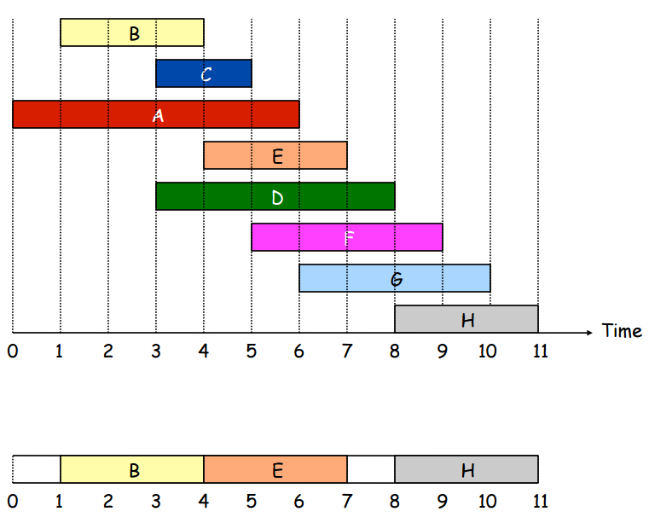
Example
Sort based on the finish time: B, C, A, E, D, F, G, H

Slide 24
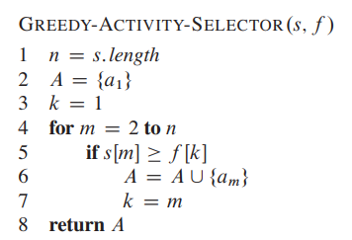
Greedy Algorithm to solve the activity-selection
Select the first activity because it has the minimum finish time
s: start times array
f: finish times array
n: number of activities
Sorted array: O(n)
Unsorted array: O(n.logn+n)=O(n.logn)

Slide 25
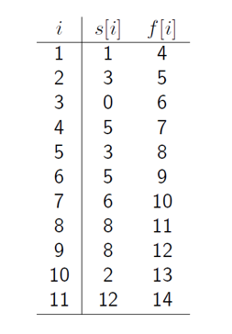

Example
Use greedy approach and find set of the maximum number of activities
$$A=\left\{1, 4, 8, 11\right\}$$

Slide 26
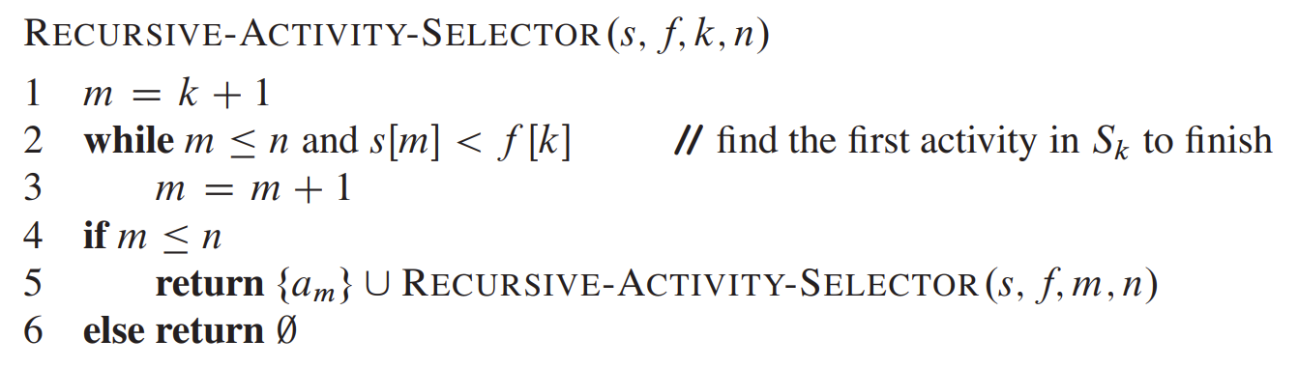
Recursive Greedy Algorithm to solve the activity-selection
s: start times array
f: finish times array
n: number of activities
k: defines the subproblem S_{k} to solve

Slide 27
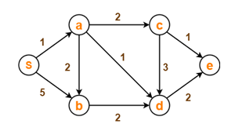
Dijkstra Algorithm: Single Source, Shortest Path in a Directed Graph
Finding the shortest path from one node to all other nodes
We assume the graph is connected
There is at least one path from the source vertex to the rest of vertices
Assume that all edge weights in the input graph are non-negative
Dijkstra is a greedy algorithm that selects the closest neighboring vertex at each step and always find the best answer (the shortest path)

Slide 28
Dijkstra's Shortest Path Algorithm
Find shortest path from S:
min
min
32,B
∞
9,S
Distance from S to G
∞
33,A
X
X
X
A
24
G
0
9
min
S
14,S
18
14
∞
35,C
34,G
X
2
X
6
B
44,B
X
∞
E
19
X
11
∞
30
D
X
15
45,D
5
20
6
min
16
min
C
44
59,C
F
∞
15,S
∞
X
X
X
min
51,G
X
min
50,D

Slide 29
Dijkstra's Shortest Path Algorithm
9
32
A
24
G
9
s
14
18
14
6
B
2
45
30
34
E
19
11
15
D
5
6
20
16
C
F
44
50
15

Slide 30
Dijkstra Algorithm
Dijkstra(G,w,s) { // G: graph, w: weight, s: source
Initialize-source-node(G,s);
S=null; //selected vertices
Q=V;
While (Q ≠ null){
u=extract_min(Q); //Q-{u}: remaining vertices
S=S U {u};
For each vertex vϵ G.adjacent[u]
Relax(u,v,w); } //update shortest path by edges from u to v
}
Relax(u, v, w){
if d[v] > d[u] + w(u, v) then d[v] = d[u] + w(u, v);
parent[v] = u;
}
d[u]
d[v]
u
w(u,v)
v
s

Slide 31
Complexity analysis of Dijkstra Algorithm
Use a priority queue (commonly implemented as a binary heap)
Dijkstra(G,w,s)
Initialize-source-node(G,s)
S=null
Q=V
While (Q ≠ null)
u=extract_min(Q)
S=S U {u}
For each vertex vϵ G.adjacent[u]
Relax(u,v,w)
O(V)
Extracting the minimum from a binary heap takes O(log V) Total vertex processing: O(V.log V)
Each edge is processed once, and updating the priority queue when a shorter path is found takes O(log⁡ V) Total edge processing: O(E.log V)
O((V+E)log V)

